Slide 1
Collaborative Filtering
Harnessing quality judgments of other users or items
Professor Wei-Min Shen
University of Southern California
Thanks for source slides and material to:
J. Leskovec, A. Rajaraman, J. Ullman: Mining of Massive Datasets
http://www.mmds.org

Slide 2
Three Approaches to Recommendation Systems
1) Content-based (consider single user)
Use characteristics of an item
Recommend items that
have similar content to items that the user liked in the past
match pre-defined attributes of the user
2) Collaborative filtering (consider other users)
Build a model from
a user's past behavior (e.g., items previously purchased or rated), and
similar decisions made by other users
Use the model to predict items that the user may like
Collaborative: suggestions made to a user utilizing information across the entire user base
3) Hybrid approaches

Slide 3
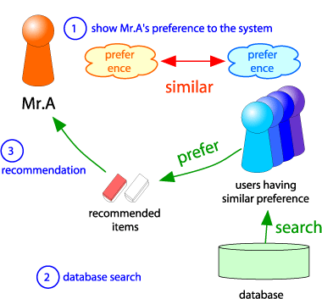
Collaborative Filtering Example
User-based collaborative filtering
Consider user x
Find set N of other users whose ratings are “similar” to x’s ratings
Estimate x’s ratings based on ratings of users in N
x
N

Slide 4
Collaborative Filtering: Overview
CF works by collecting user feedback: e.g., ratings for items
Exploit similarities in rating behavior among users in determining recommendations
Two classes of CF algorithms:
Neighborhood-based or Memory-based approaches
User-based CF
Item-based CF
Model-based approaches
Estimate parameters of statistical models for user ratings
Latent factor and matrix factorization models

Slide 5
NEIGHBORHOOD-BASED OR MEMORY-BASED COLLABORATIVE FILTERING

Slide 6
USER-BASED CF
Identify User’s Neighbors => Recommendation

Slide 7
Neighborhood-based / Memory-based Collaborative Filtering
Active user: the user we want to make predictions for
User-based CF: A subset of other users (neighborhood) is chosen based on their similarity to the active user
A weighted combination of the ratings of neighbors is used to make predictions for the active user
Steps:
Assign a weight to all users w.r.t. similarity with the active user
Select k neighbor users that have the highest similarity with active user (the neighborhood)
Compute a prediction from a weighted combination of the selected neighbors’ ratings
Notes:
evening

Slide 8
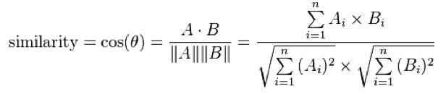
Similarity between users: by what measure?
Weight w_{x,y} is measure of similarity between user x and active user y
Let r_{x} be the vector of user x’s ratings
Possible similarity metrics:
Jaccard similarity
(Intersection / union) of two sets
Doesn’t use non-boolean values: e.g., ratings
Cosine similarity
Treat ratings as vectors to points
Cosine similarity between points
r_{x}, r_{y} as sets:
r_{x} = {1, 4, 5}
r_{y} = {1, 3, 4}
r_{x}, r_{y} as points:
r_{x} = {1, 0, 0, 1, 3}
r_{y} = {1, 0, 2, 2, 0}

Slide 9
JACCARD SIMILARITY
Similarity between users: by what measure?

Slide 10
Jaccard Similarity and Distance of Sets
The Jaccard similarity of two sets is the size of their intersection divided by the size of their union
Sim (C₁, C₂) = |C₁∩C₂|/|C₁∪C₂|
Jaccard distance = 1 – Jaccard Similarity

Slide 11
Example: Jaccard Similarity and Distance
3 in intersection
8 in union
Jaccard similarity = 3/8
Jaccard distance = 1 – Jaccard Similarity or 5/8 in this example
Notes:
morning

Slide 12
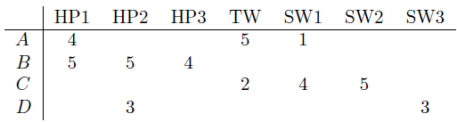
How well do these similarity metrics work?
Movies
Users
Intuitively we want: sim(A, B) > sim(A, C) (why?)
For A and B: One movie rated in common with similar ratings
For A and C: Two movies rated in common but with dissimilar ratings
Jaccard similarity (Example 9.7)
Ignores values (rates) in matrix
Only look at which items are rated in matrix
Intersection / union: sim(A,B) = 1/5, sim(A,C) = 2/4
1/5 < 2/4 indicates sim(A,B) < sim(A,C)
Not a good similarity metric for ratings data!
Notes:
HP: Harry Potter
TW: Twilight
SW: Star Wars
4/25 0.16 3/20 0.15

Slide 13
COSINE SIMILARITY
Similarity between users: by what measure?

Slide 14

Same matrix with cosine similarity (Example 9.8)
Treat blanks as 0 value: questionable, since it treats no rating as more similar to disliking a movie than liking it
Cosine similarity of A and B is:
Cosine similarity of A and C is: 0.322
0.380 > 0.322: Indicates A,B slightly more similar than A,C
in this case, cosine similarity better than Jacquard similarity

Slide 15
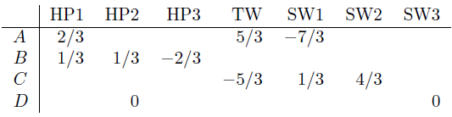
Normalizing ratings (Example 9.9)
To deal better with non-rated items
Subtract the average rating of that user from each rating
low ratings -> negative numbers; high ratings -> positive numbers
Avg. Rating
10/3
14/3
11/3
6/2
(V – Avg)
Cosine sim A,B vs. A,C: 0.092 > -0.559 (85 degrees vs 124 degrees)
A, C are much further apart than A, B, but neither is close

Slide 16
PEARSON CORRELATION
Similarity between users: by what measure?

Slide 17
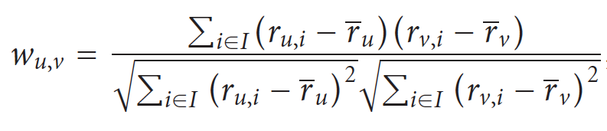


Most commonly used measure of similarity: Pearson Correlation Coefficient
Pearson correlation measures extent to which two variables linearly related
For users u, v: Pearson correlation is
And r_{u,i} is rating of item i by user u
Note: When calculating these similarities, average only over the co-rated items // so be careful
average
average
Notes:
201601 03

Slide 18
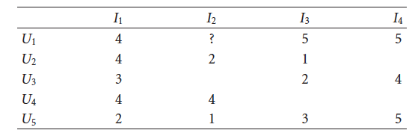
Example: Pearson Correlation Coefficient
14/3
10/3
11/4
Want correlation of user 1, user 5: w_{1,5} Set I of co-rated movies = {I₁, I₃, I₄}
For user 1: average rating on co-rated movies is 14/3; For user 5: 10/3
Numerator: (4 - 14/3)(2 - 10/3) + (5- 14/3)(3- 10/3) + (5-14/3)(5-10/3) = 12/9 = 1.3333
Denominator: sqrt[(4-14/3)² + (5-14/3)² + (5-14/3)²] *sqrt[(2-10/3)² + (3-10/3)² + (5-10/3)²] = 1.76383
Pearson correlation w_{1,5}= 1.3333 / 1.76383 = 0.756
Notes:
denomiator

Slide 19
Example: Pearson Correlation Coefficient
?
?
Want correlation of user 1, user 4: w_{1,4} Set I of co-rated movies = {?,?}
For user 1: average rating on co-rated movies is ?; For user 4 is ?
Numerator:
Denominator:
Pearson correlation w_{1,4} = 0
Notes:
denomiator

Slide 20
Example: Pearson Correlation Coefficient
9/2
5/2
Want correlation of user 1, user 2: w_{1,2} Set I of co-rated movies = {I₁, I₃}
For user 1: average rating on co-rated movies is 9/2; For user 2: 5/2
Numerator: (4–4.5)(4–2.5) + (5-4.5)(1-2.5) = -0.5(1.5) + 0.5(-1.5) = -1.5
Denominator: sqrt((4-4.5)² + (5-4.5)²)*sqrt((4-2.5)² + (1-2.5)²) = sqrt(0.5)*sqrt(1.5²*+1.5²) = sqrt(0.5)sqrt(4.5) = 1.5
Pearson correlation w_{1,2} = -1.5 / 1.5 = -1
Notes:
denomiator

Slide 21
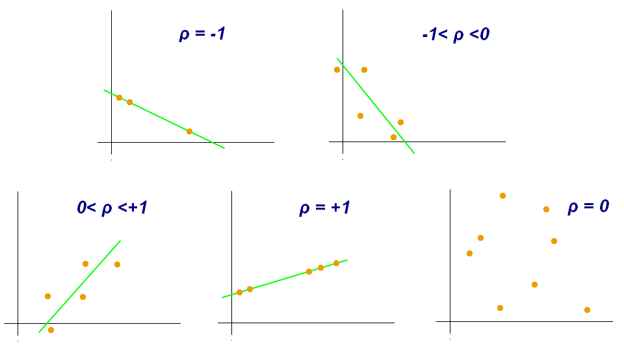
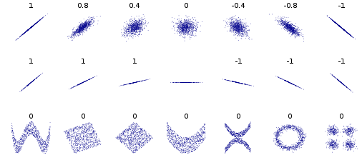
Pearson Correlation Examples
Source: https://en.wikipedia.org/wiki/Pearson_product-moment_correlation_coefficient

Slide 22
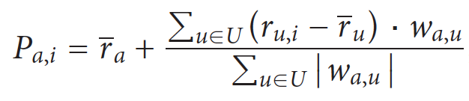
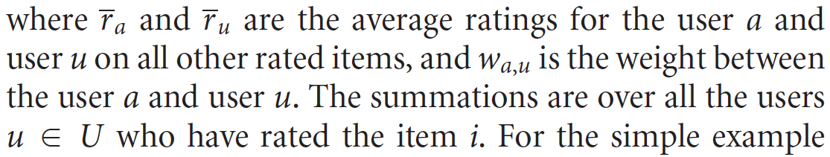
Making User-based CF Predictions with Pearson: Weighted Sum of Other Users’ Ratings
Weighted average of their ratings is used to generate predictions
To make a prediction for an active user a on an item i:
Note: When making predictions, calculate average of ALL rated items for users a and u
Summation is over all users who rated item i
other people’s opinion
Your own opinion
How much
you like u

Slide 23
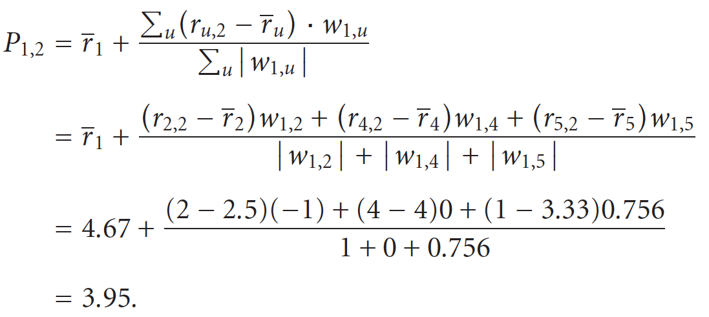
Continued Example: User-Based CF Prediction with Pearson Correlation Coefficient
“average other
than I2”
(4+5+5)/3
(4+1)/2
(4)/1
(2+3+5)/3
Want to predict rating for user U1 on item I2: users U2, U4 and U5, who rated I2
Similarity of U1 to these users: w_{1,5} = 0.756, w_{1,4} = 0, w_{1,2} = -1
14/3 = 4.67
5/2=2.5
4/1=4
10/3=3.33

Slide 24
Neighborhood-Based algorithms
In neighborhood-based CF algorithms, a subset of nearest neighbors of the active user are chosen based on their similarity with active user
Use these users for predictions rather than all users who have rated the item

Slide 25
ITEM-BASED CF
Item’s Neighbors 🡪 Recommendations
Notes:
201603.2 w2.1
201802 w1.1

Slide 26
Item-based Collaborative Filtering
Neighborhood-based CF algorithms do not scale well when applied to millions of users & items
Due to computational complexity of search for similar users (possible solutions?)
Item-to-item collaborative filtering
Rather than matching similar users
Match user’s rated items to similar items
In practice, often leads to faster online systems and better recommendations
Similarities between pairs of items i and j are computed off-line
Predict rating of user “a” on item “i" with a simple weighted average
Notes:
2016.3 w2.1

Slide 27
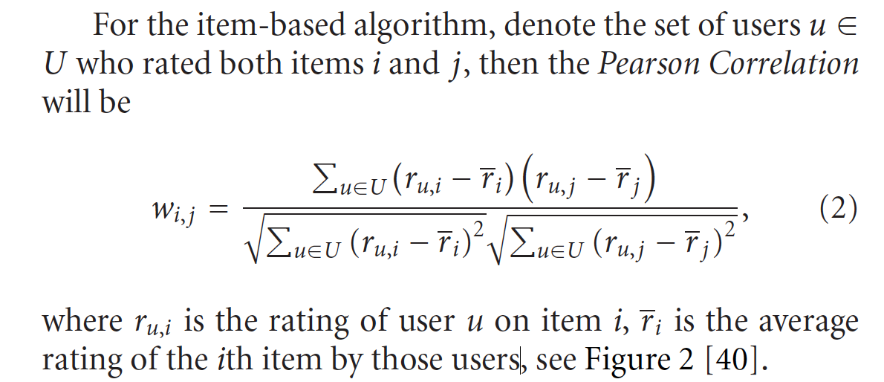
Pearson Correlation between items i, j
_
Note: Sum over set of users U who rated both items i, j
r_{u,i} is rating of user u on item i
r_{i} is average rating of i^{th} item by those users

Slide 28
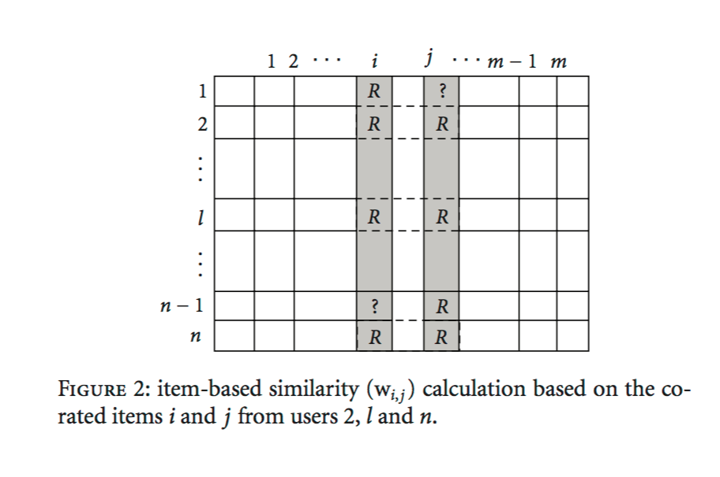
Pearson Correlation between items i, j (Cont’d)
Items
Users
Source: Su, X., & Khoshgoftaar, T. M. (2009). A survey of collaborative filtering techniques. Advances in artificial intelligence, 2009, 4.

Slide 29
Recall: Pearson Correlation Coefficient
Pearson correlation measures extent to which two variables linearly related
For users u, v: Pearson correlation is
And r_{u,i} is rating of item i by user u
Note: When calculating these similarities, look only at the co-rated items

Slide 30
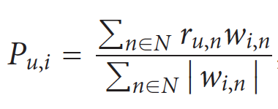
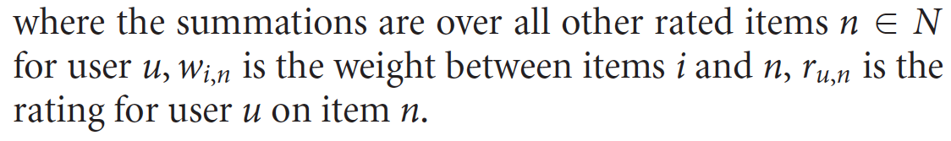
Make Item-Based Predictions Using a Simple Weighted Average
In order to predict rating for user u on item i, do
w_{i,n} is the (similarity) weight between item i and item n
r_{u,n} is rating for user u on item n
Summation over neighborhood set N of items rated by u that are most similar to i
User’s opinion on the item n
How similar
is n to i

Slide 31
Item-Item CF (|N|=2)
users
12 | 11 | 10 | 9 | 8 | 7 | 6 | 5 | 4 | 3 | 2 | 1
 | 4 |  | 5 |  |  | 5 |  |  | 3 |  | 1 | 1
3 | 1 | 2 |  |  | 4 |  |  | 4 | 5 |  |  | 2
 | 5 | 3 | 4 |  | 3 |  | 2 | 1 |  | 4 | 2 | 3
 | 2 |  |  | 4 |  |  | 5 |  | 4 | 2 |  | 4
5 | 2 |  |  |  |  | 2 | 4 | 3 | 4 |  |  | 5
 | 4 |  |  | 2 |  |  | 3 |  | 3 |  | 1 | 6
movies (items)
- unknown rating
- rating between 1 to 5

Slide 32
Item-Item CF (|N|=2)
users
12 | 11 | 10 | 9 | 8 | 7 | 6 | 5 | 4 | 3 | 2 | 1
 | 4 |  | 5 |  |  | 5 | ? |  | 3 |  | 1 | 1
3 | 1 | 2 |  |  | 4 |  |  | 4 | 5 |  |  | 2
 | 5 | 3 | 4 |  | 3 |  | 2 | 1 |  | 4 | 2 | 3
 | 2 |  |  | 4 |  |  | 5 |  | 4 | 2 |  | 4
5 | 2 |  |  |  |  | 2 | 4 | 3 | 4 |  |  | 5
 | 4 |  |  | 2 |  |  | 3 |  | 3 |  | 1 | 6
movies (items)
- estimate rating of movie 1 by user 5

Slide 33
Item-Item CF (|N|=2) First: what is similarity between items?
users
Similarity (made up for example):
w_{1,j}
12 | 11 | 10 | 9 | 8 | 7 | 6 | 5 | 4 | 3 | 2 | 1
 | 4 |  | 5 |  |  | 5 | ? |  | 3 |  | 1 | 1
3 | 1 | 2 |  |  | 4 |  |  | 4 | 5 |  |  | 2
 | 5 | 3 | 4 |  | 3 |  | 2 | 1 |  | 4 | 2 | 3
 | 2 |  |  | 4 |  |  | 5 |  | 4 | 2 |  | 4
5 | 2 |  |  |  |  | 2 | 4 | 3 | 4 |  |  | 5
 | 4 |  |  | 2 |  |  | 3 |  | 3 |  | 1 | 6
1.00
-0.18
0.41
-0.10
-0.31
0.59
movies (items)
Neighbor selection: Identify movies most similar to movie 1 and rated by user 5
Neighborhood size is 2: pick movies 3 and 6

Slide 34
Item-Item CF (|N|=2)
users
Similarity (made up):
w_{1,j}
12 | 11 | 10 | 9 | 8 | 7 | 6 | 5 | 4 | 3 | 2 | 1
 | 4 |  | 5 |  |  | 5 | ? |  | 3 |  | 1 | 1
3 | 1 | 2 |  |  | 4 |  |  | 4 | 5 |  |  | 2
 | 5 | 3 | 4 |  | 3 |  | 2 | 1 |  | 4 | 2 | 3
 | 2 |  |  | 4 |  |  | 5 |  | 4 | 2 |  | 4
5 | 2 |  |  |  |  | 2 | 4 | 3 | 4 |  |  | 5
 | 4 |  |  | 2 |  |  | 3 |  | 3 |  | 1 | 6
1.00
-0.18
0.41
-0.10
-0.31
0.59
movies/items
Similarity weights between items: w_{1,3}=0.41, w_{1,6}=0.59

Slide 35
Item-Item CF (|N|=2)
users
Similarity:
w_{1,j}
12 | 11 | 10 | 9 | 8 | 7 | 6 | 5 | 4 | 3 | 2 | 1
 | 4 |  | 5 |  |  | 5 | 2.6 |  | 3 |  | 1 | 1
3 | 1 | 2 |  |  | 4 |  |  | 4 | 5 |  |  | 2
 | 5 | 3 | 4 |  | 3 |  | 2 | 1 |  | 4 | 2 | 3
 | 2 |  |  | 4 |  |  | 5 |  | 4 | 2 |  | 4
5 | 2 |  |  |  |  | 2 | 4 | 3 | 4 |  |  | 5
 | 4 |  |  | 2 |  |  | 3 |  | 3 |  | 1 | 6
1.00
-0.18
0.41
-0.10
-0.31
0.59
movies
Predict by taking weighted average:
P_{1.5} = (0.41*2 + 0.59*3) / (0.41+0.59) = 2.6

Slide 36
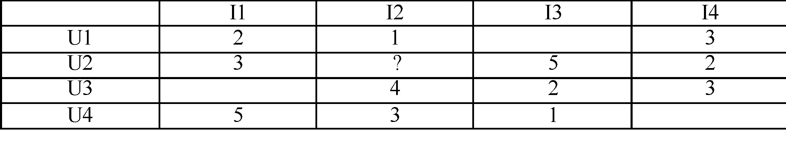
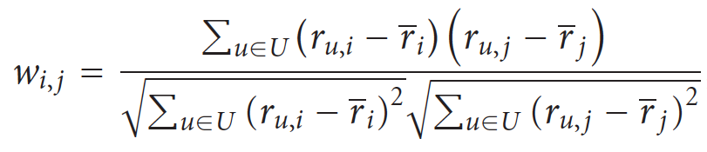
Example: Item-to-Item Collaborative Filtering with Pearson Similarity
What does set U represent?
Set of users U who rated both items i, j
What are the members of the set U for w_{1,2}?
U1 and U4 rated items I1 and I2
When calculating average ratings for item i, which ratings do we use? All ratings or just for co-rated items?
We will show examples of co-rated items
We can use all ratings as well: based on all ratings: avg(r₁) = (2+3+5)/3, avg(r₂) = (1+4+3)/3
Notes:
2017 spring 0201
2018 Spring 0201

Slide 37
Example: Item-to-Item Collaborative Filtering with Pearson Similarity
Based on all ratings: average ratings for items I1, I2: r₁ = 10/3, r₂ = 8/3
Pearson correlation for w_{1,2:} Similarity between items 1 and 2
Set U includes U1 and U4
w_{1,2} = ((r_{U1,I1} – 10/3)(r_{U1,I2} – 8/3) + (r_{U4,I1} – 10/3)(r_{U4,I2} – 8/3)) /
(sqrt((r_{U1,I1} – 10/3)＾2 + (r_{U4,I1} – 10/3)^2) * sqrt((r_{U1,I2} – 8/3)^2) + (r_{U4,I2} – 8/3)^2))
w_{1,2} = [(2-10/3)(1-8/3) + (5-10/3)(3-8/3)] /
[sqrt((2-10/3)^2 + (5-10/3)^2) * sqrt((1-8/3)^2 + (3-8/3)^2)]
= 2.778/3.628 = 0.765

Slide 38
Example: Item-to-Item Collaborative Filtering with Pearson Similarity
co-rated items only
Based on co-ratings: average ratings for items I1, I2: r₁ = 7/2, r₂ = 4/2
Pearson correlation for w_{1,2:} Similarity between items 1 and 2
Set U includes U1 and U4
w_{1,2} = ((r_{U1,I1} – 7/2)(r_{U1,I2} – 4/2) + (r_{U4,I1} – 7/2)(r_{U4,I2} – 4/2)) /
(sqrt((r_{U1,I1} – 7/2)＾2 + (r_{U4,I1} – 7/2)^2) * sqrt((r_{U1,I2} – 4/2)^2) + (r_{U4,I2} – 4/2)^2))
w_{1,2} = [(2-7/2)(1-4/2) + (5-7/2)(3-4/2)] /
[sqrt((2-7/2)^2 + (5-7/2)^2) * sqrt((1-4/2)^2 + (3-4/2)^2)]
=3/3=1

Slide 39
Item-Based Prediction
If we have the following item similarities: w_{2,1} = 0.5, w_{2,3} = 0.2, w_{2,4} = 0.3
Which items are in the neighborhood N for item 2 if |N| = 2?
Items I1 and I4
Predict the rating of user U2 on I2: user = 2, item = 2, |N| = items 1,4
P_{2,2} = [(r_{2,1} * w_{2,1}) + (r_{2,4} * w_{2,4})] / [0.5 + 0.3]
= [3*0.5 + 2*0.3] / 0.8 = 2.625

Slide 40
EXTENSIONS TO MEMORY-BASED ALGORITHMS

Slide 41
Extensions to Memory-Based Algorithms
A variety of approaches/extensions have been studied to improve the performance of CF predictions
Typically involve modifying the similarity weights or the ratings used in predictions or guessing missing ratings
User-based CF: (User’s Neighbors => recommend)
Item-Based CF: (Item’s Neighbors => recommend)

Slide 42
Extensions to Memory-Based Algorithms: Default Voting
In many collaborative filters, pairwise similarity is computed only from the ratings in the intersection of the items both users have rated (“co-rated items”)
Not reliable when there are too few votes to generate similarity values (U is small)
Focusing on co-rated items (“intersection set similarity”) also neglects global rating behavior reflected in a user’s entire rating history
Assuming some default voting values for the missing ratings: can improve CF prediction performance

Slide 43
Extensions to Memory-Based Algorithms: Default Voting (cont.)
Approaches to default voting values:
Herlocker et al. accounts for small intersection sets (small number of co-rated items) by reducing the weight of users that have fewer than 50 items in common
Chee et al. use average of the clique (small group of co-rated items) as a default voting to extend a user’s rating history
Breese et al. use a neutral or somewhat negative preference for the unobserved ratings and then computes similarity between users on the resulting ratings data.

Slide 44
Extensions to Memory-Based Algorithms: Inverse User Frequency
Universally liked items are not as useful in capturing similarity as less common items
Inverse frequency
f_{j} = log (n/n_{j})
n_{j} is number of users who have rated item j
n is total number of users
If everyone has rated item j, then f_{j} is zero
(Note: looks a lot like Inverse Document Frequency (IDF))
Approach: transform the ratings
For vector similarity-based CF: new rating = original rating multiplied by f_{j}
For very popular items, ratings r_{u,i} will be greatly reduced
Less popular items will have greater effect on prediction

Slide 45

Extensions to Memory-Based Algorithms: Case Amplification
Transform applied to weights used in CF prediction
Emphasizes high weights and punishes low weights
Transforms original weights
Reduces noise in the data
Favors high weights
Small values raised to a power become negligible
Example:
For w_{i, j} = 0. 9, weight it remains high (0. 9^{2.5} ≈ 0. 8)
For w_{i, j} = 0. 1, weight becomes negligible (0. 1^{2.5} ≈ 0. 003)

Slide 46
Extensions to Memory-Based Algorithms: Imputation-Boosted CF
When the rating data for CF tasks are extremely sparse: hard to produce accurate predictions using the Pearson correlation-based CF
Su et al. proposed imputation-boosted collaborative filtering (IBCF)
First uses an imputation technique to fill in missing data
Then use traditional Pearson correlation-based CF algorithm on this completed data to predict a user rating for a specified item
Example imputation techniques: mean imputation, linear regression imputation, predictive mean matching imputation, Bayesian multiple imputation, and machine learning classifiers (including naıve Bayes, SVM, neural network, decision tree, lazy Bayesian rules)

Slide 47
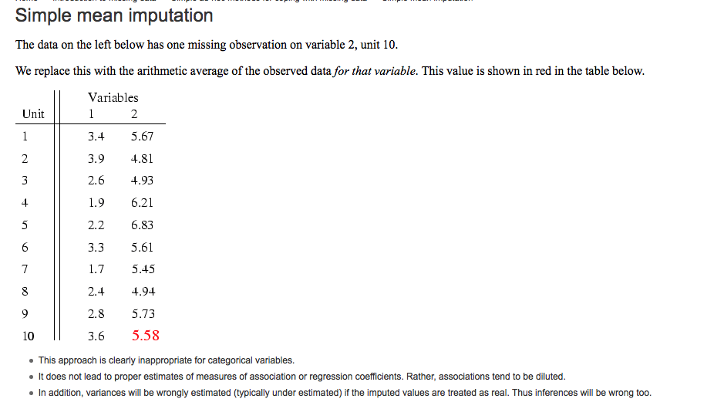
Extensions to Memory-Based Algorithms: Imputation-Boosted CF (Cont’d)
Imputation Example
Source: http://missingdata.lshtm.ac.uk/index.php?option=com_content&view=article&id=68:simple-mean-imputation&catid=39:simple-ad-hoc-methods-for-coping-with-missing-data&Itemid=96

